Slide 1


VIRTUAL INTELLIGENCE SERVICE
VICTORIA PER INTELLECTUM
INTSUM VIS GROUND
OPAR D+1
DISCLAIMER:
This is for multiplayer online gaming using the Digital Combat Systems simulation software published by Eagle Dynamics. The information is not in any way suitable for real world use or operations.
Version: 1.0
Published: 2020-09-19

Slide 2
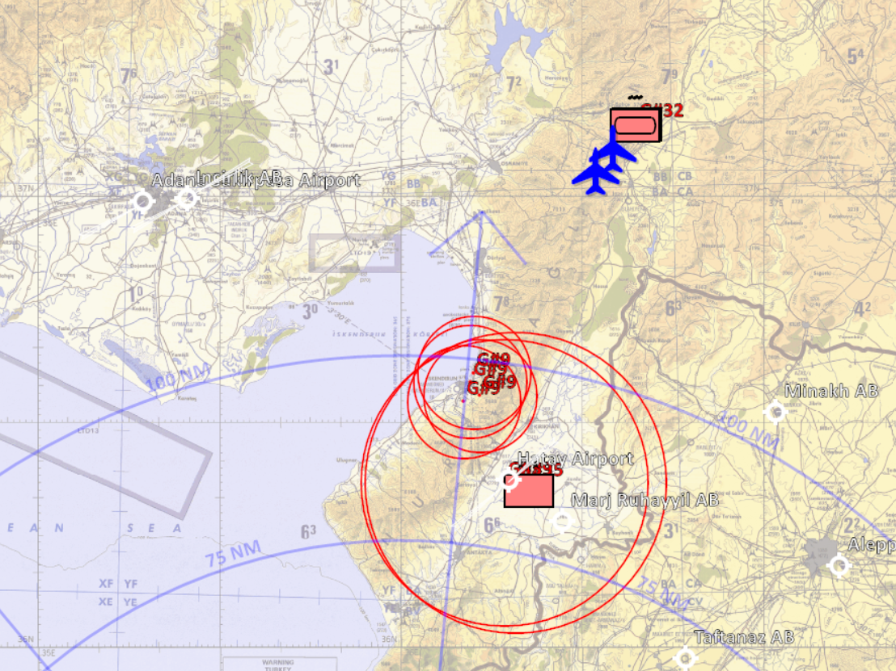
MAJOR EVENTS LAST PERIOD
Syrian 1st Corps:
Took a heavy punch to the nose.
Corps HQ has been wiped out along with it’s SA-6 Battalion and one of the SA-11 batteries.
In the city of Iskenderun all SA-15’s supporting 11th Mechanized Division HQ have been neutralized.
To the north 10th Armored Division lost some platoons, which was spotted furth north than initially anticipated.
We lost two KA-50 in the North along with a single F/A-18.
INSERT MAP HERE
A
A
B
B
C
C
D
D
E
E
F
F

Slide 3
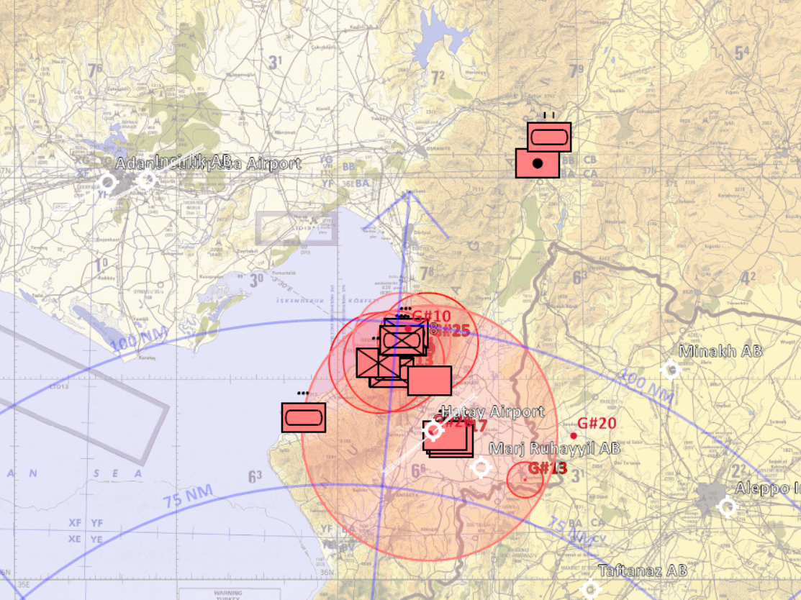
MAJOR EVENTS LAST PERIOD
Syrian 1st Corps:
One or two artillery section of Msta or Akatsia have been spotted G#33.
11th Mechanized Division is occupying Iskenderun, but there have been reports of BTR-80’s G#15 to the south of the city indicating that 12th Motorized Division has sent reinforcements.
Armor has also been reported to the south west of the city G#19.
Sborka is reported in the hill north east of the city G#25. SA-15 mentioned G#29 is believed to be same as the one reported destroyed G#9.
SA-6 spotted G#40 and possible EWR G#41.
Tent structure G#30 is evaluated as a field hospital an must NOT be engaged.
INSERT MAP HERE
A
A
B
B
C
C
D
D
E
E
F
F

Slide 4
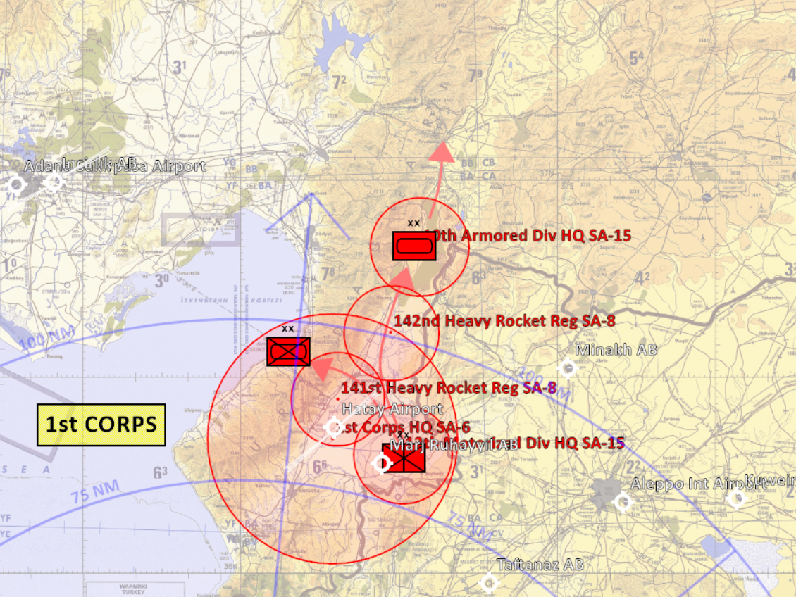
MAJOR EVENTS LAST PERIOD
Syrian 1st Corps:
One SA-11 batteries supporting 1st Corps HQ is unacounted for.
10th Armored Division and 12th Motorized Division Division HQ SA-15’s are unacounted for.
Un-confirmed locations of Heavy Rocket Regiments SA-8, but one of the Heavy Rocket Regiments is believed to be further the north to support advancing forces of 10th Amored Division.
INSERT MAP HERE
A
A
B
B
C
C
D
D
E
E
F
F

Slide 5
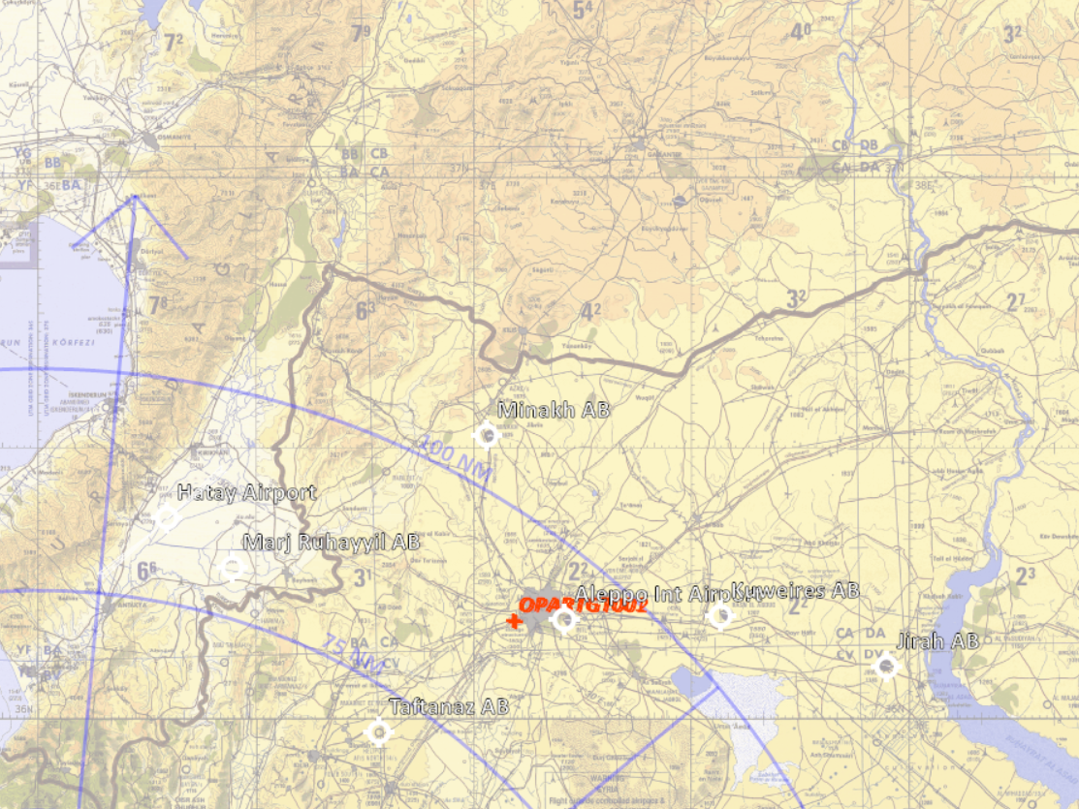
MAJOR EVENTS LAST PERIOD
Syrian 2nd Corps:
Both Syrian army HQ building (OPARTGT001 & OPARTGT002 ) in the city of Aleppo has been destroyed.
INSERT MAP HERE
A
A
B
B
C
C
D
D
E
E
F
F

Slide 6
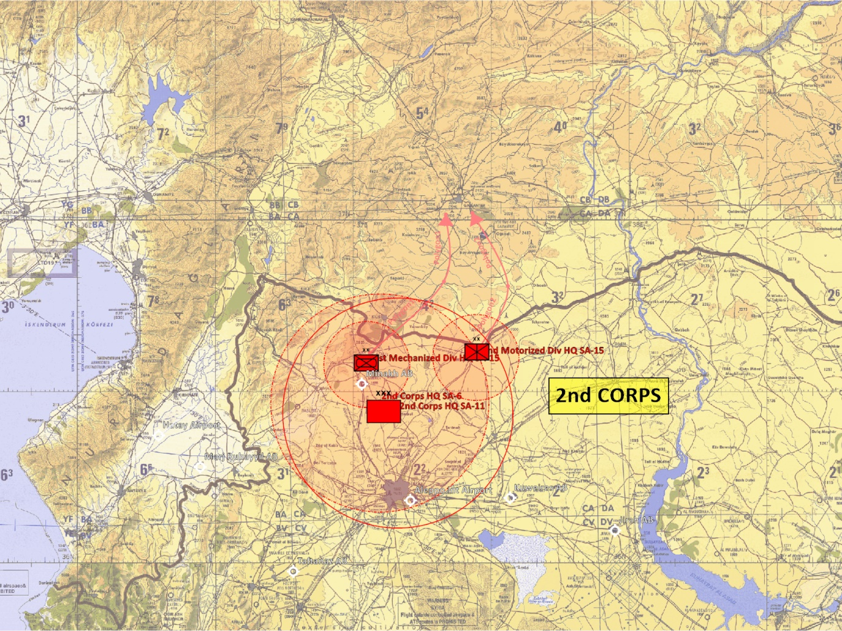
MAJOR EVENTS LAST PERIOD
Syrian 2nd Corps:
No further INTEL in this area. INTEL from D+1 still stands:
«Is of last reports stationary south-east of Minakh (N36º 31.000 E037º 02.000). However is anticipated to push north into turkey towards Gaziantep.
2nd Corps is a slightly decimated Corps missing the a Amored Division, Air Defence Division as well as Rocket Artillery Regiment.
21st Mechanized Division, has moved forward to the border, IVO N36 35.000 E037 03.000.
22nd Motorized Division, has moved forward to the border, IVO N36.37.000 E037 27.000.
Un-confirmed locations of SA-15, SA6 & SA-11»
INSERT MAP HERE
A
A
B
B
C
C
D
D
E
E
F
F

Slide 7
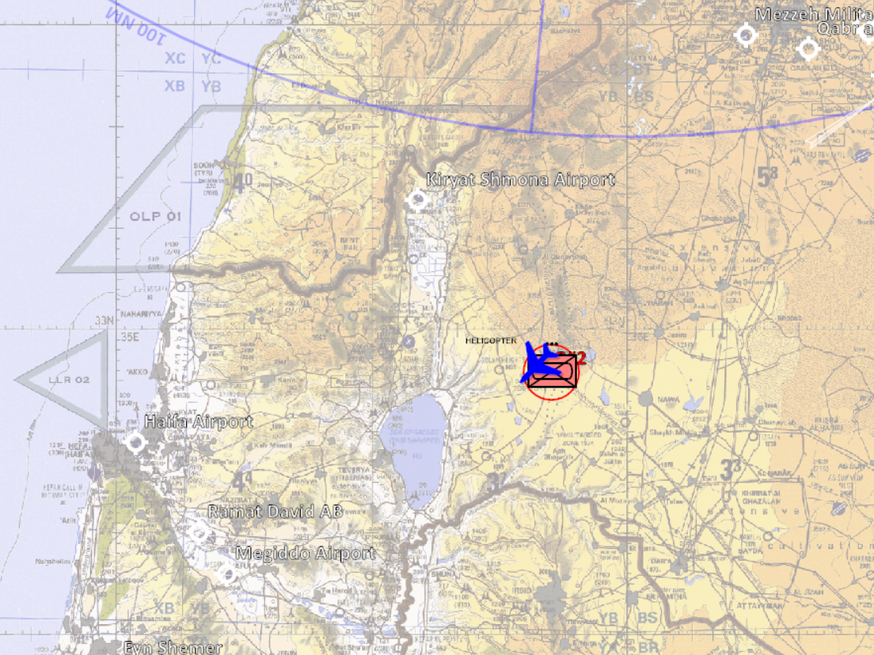
MAJOR EVENTS LAST PERIOD
Syrian 3rd Corps:
Lost some platoon of BMP-2’s, along with a few Shilka’s and SA-13’s.
2xKA-50 lost and 1xA-10C took heavy damage.
INSERT MAP HERE
A
A
B
B
C
C
D
D
E
E
F
F

Slide 8
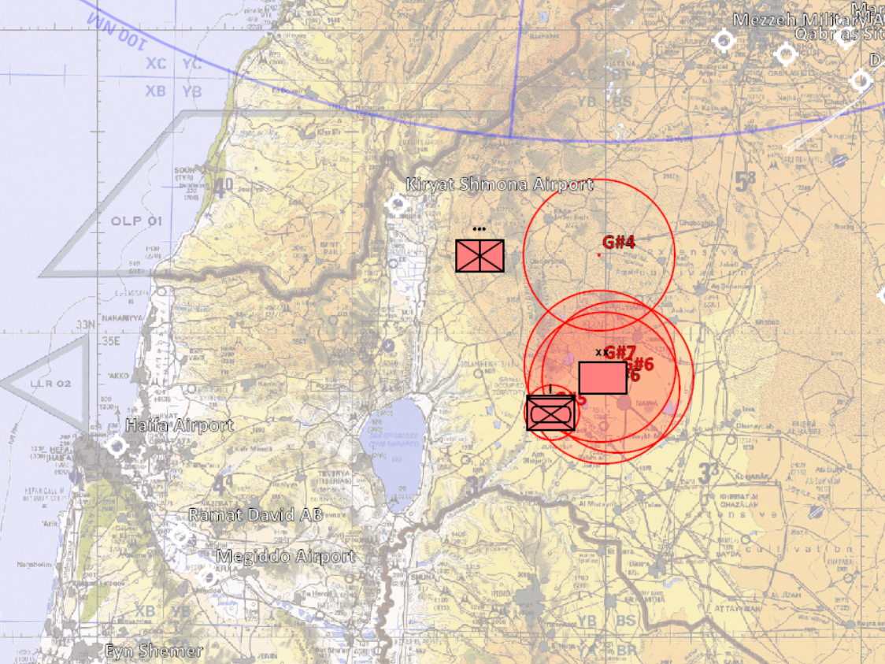
MAJOR EVENTS LAST PERIOD
Syrian 3rd Corps:
Divisional HQ sighted N32º 52.279 E035º 53.680 + Sborka, protected by 3xSA-15 sites G#6.
G#7 gives location of one of the three SA-15 sites.
Mechanized company spotted G#5, protected by Shilka and SA-13.
Further to the north a SA-15 G#4 is spotted to the rear, believed to be surporting 30th Armored Division HQ.
31st Motorized Division is further into the Golan Height area then initially anticipated G#8.
INSERT MAP HERE
A
A
B
B
C
C
D
D
E
E
F
F

Slide 9
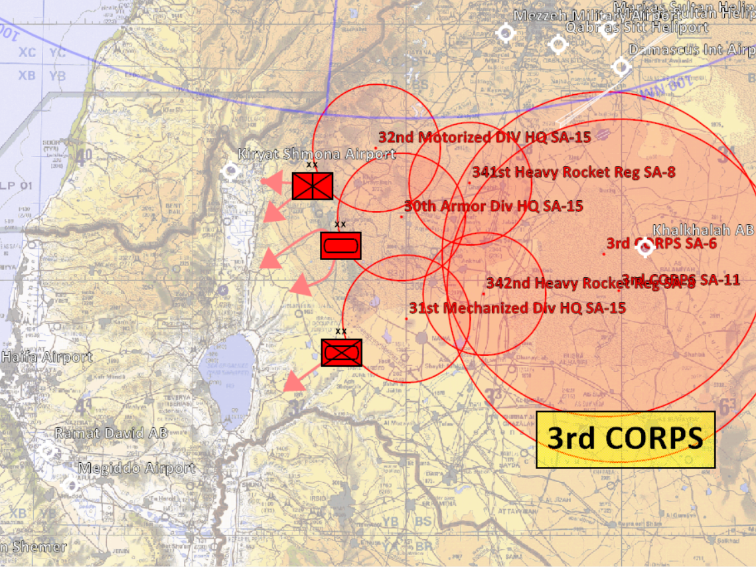
MAJOR EVENTS LAST PERIOD
Syrian 3rd Corps:
32nd Motorized Division HQ SA-15’s are un-acounted for.
Un-confirmed locations of Heavy Rocket Regiments SA-8
Un-confirmed locations of Corps HQ SA-6 & SA-11
INSERT MAP HERE
A
A
B
B
C
C
D
D
E
E
F
F

Slide 10
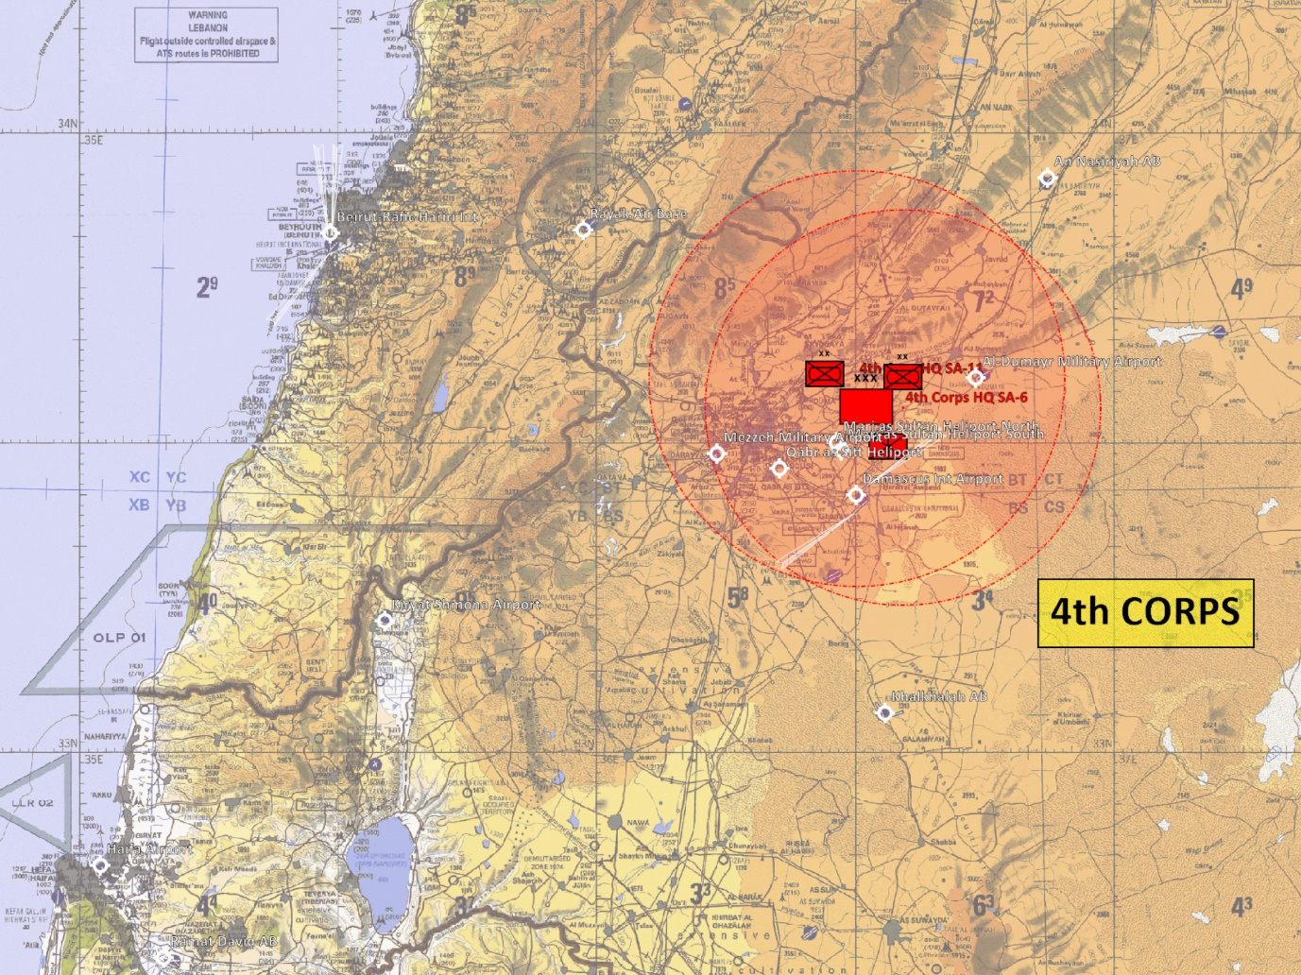
MAJOR EVENTS LAST PERIOD
Syrian 4rd Corps:
No further INTEL in this area. INTEL from D+1 still stands:
«We have no indications that 4th Corps has left their positions around Damaskus
Any sightings of the Corps reported immideately.
4th Corps has it’s main manouvre Divisions, however lacks Air Defence Division, Rockets Artillery Regiment, Reconnaissance Regiment, Helicopter Regiment and Logistics Regiment.
As such 4th Corps should be enterpretted as a reinforcement Corps, which cannot move as it lacks the infrastructure. However given their current position they have a decent infratructure within Damakus. «
INSERT MAP HERE
A
A
B
B
C
C
D
D
E
E
F
F

Slide 11
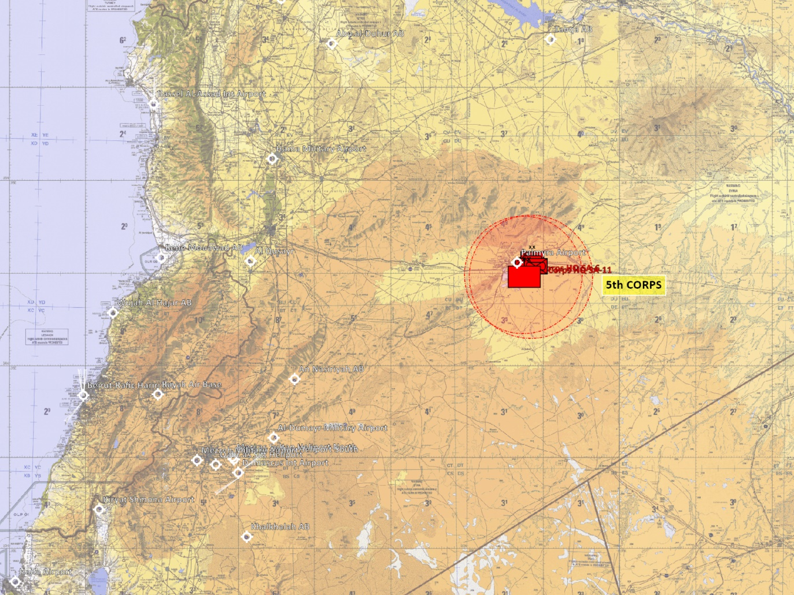
MAJOR EVENTS LAST PERIOD
Syrian 5th Corps:
No further INTEL in this area. INTEL from D+1 still stands:
«VIS has no indications that the Corps has left it’s home base of Palmyra
Any sightings of the Corps reported immideately.
5th Corps is a full strenght corps. 5th Corps is evaluated to be kept for securing the capital of Damakus if the need should arise, but at the same time is also capable of reinforcing 1st and 2nd Corps. «
INSERT MAP HERE
A
A
B
B
C
C
D
D
E
E
F
F

Slide 12
MAJOR EVENTS LAST PERIOD
SAM unit:
Armor battalions are protected by:
ZSU-23/4 + SA19 Tunguska
Mechanized Battalions are protected by:
ZSU-23/4 + SA-13 Strela-10
Motorized Battalions are protected by:
ZSU-23/4 + SA-9 Strela-1
Dash-dot lines means un-confirmed locations
INSERT MAP HERE
A
A
B
B
C
C
D
D
E
E
F
F

Slide 13
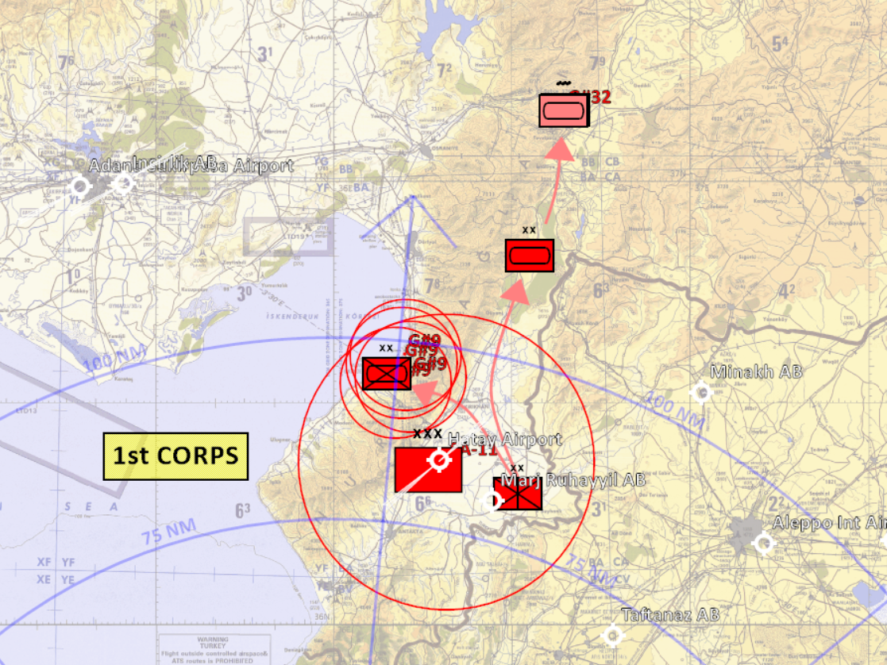
BDA LAST PERIOD
Syrian 1st Corps:
BDA:
BEAST 4xSA-14 near city of Iskenderun, Appears to be entire 1165th SA-15 Battalion supporting 11th Mechanized Division.
COBRA reported 2x platoon MBT plus 1x Shilka destroyed from 10th Armored Division
PANTHER reported 1x SA-11 SR destroyed from 1st Corps HQ. The other SA-11 battery is unacounted for.
JEDI reported 1st Corps HQ destroyed as well as 1st Corps SA-6 battery
INSERT MAP HERE
A
A
B
B
C
C
D
D
E
E
F
F

Slide 14
BDA LAST PERIOD
Syrian 2nd Corps:
Corps HQ co-located with Hatay airfield
BDA:
Viper reported OPARTGT001 and OPARTGT002, Syrian army HQ destroyed.
INSERT MAP HERE
A
A
B
B
C
C
D
D
E
E
F
F

Slide 15
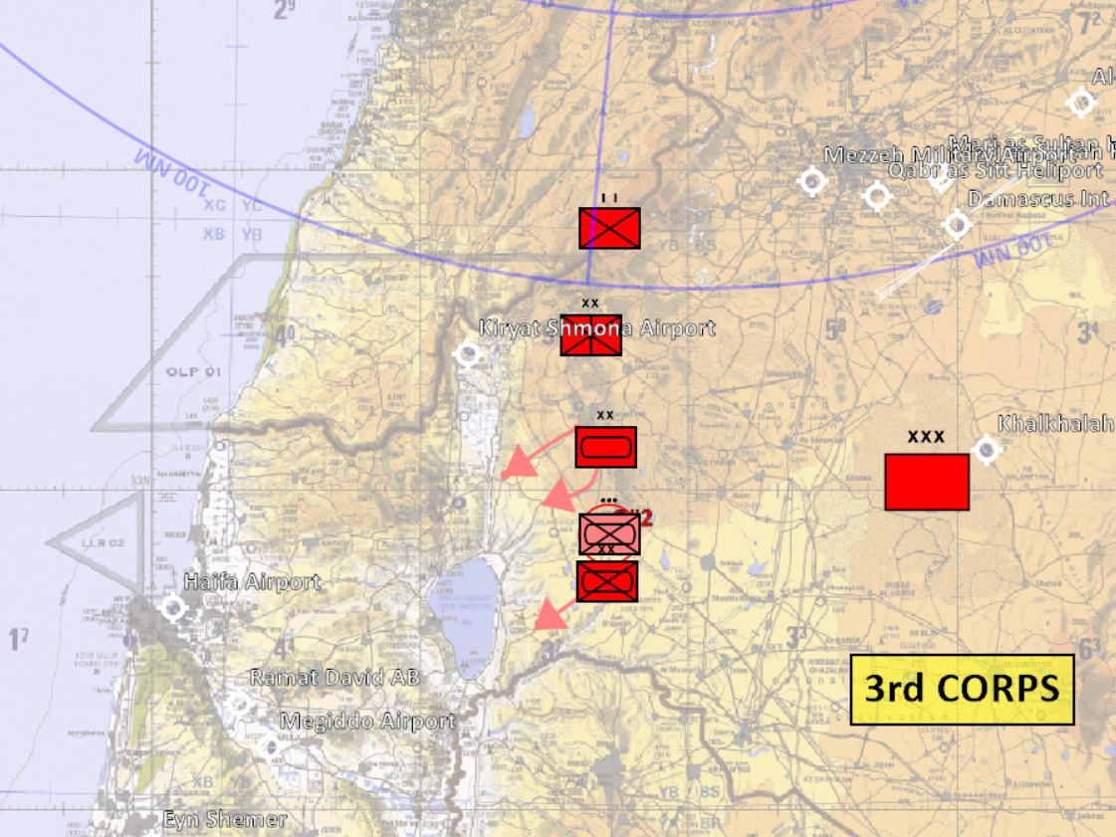
BDA LAST PERIOD
Syrian 3rd Corps:
Still occupying the de-militarized zone and the Golan height.
BDA:
DRAGON took out to two BMP-2 platoons plus one air defence platoon from 31st Mechanized Division.
AXE took out one air defence platoon from 31st Mechanized Division.
INSERT MAP HERE
A
A
B
B
C
C
D
D
E
E
F
F

Slide 16
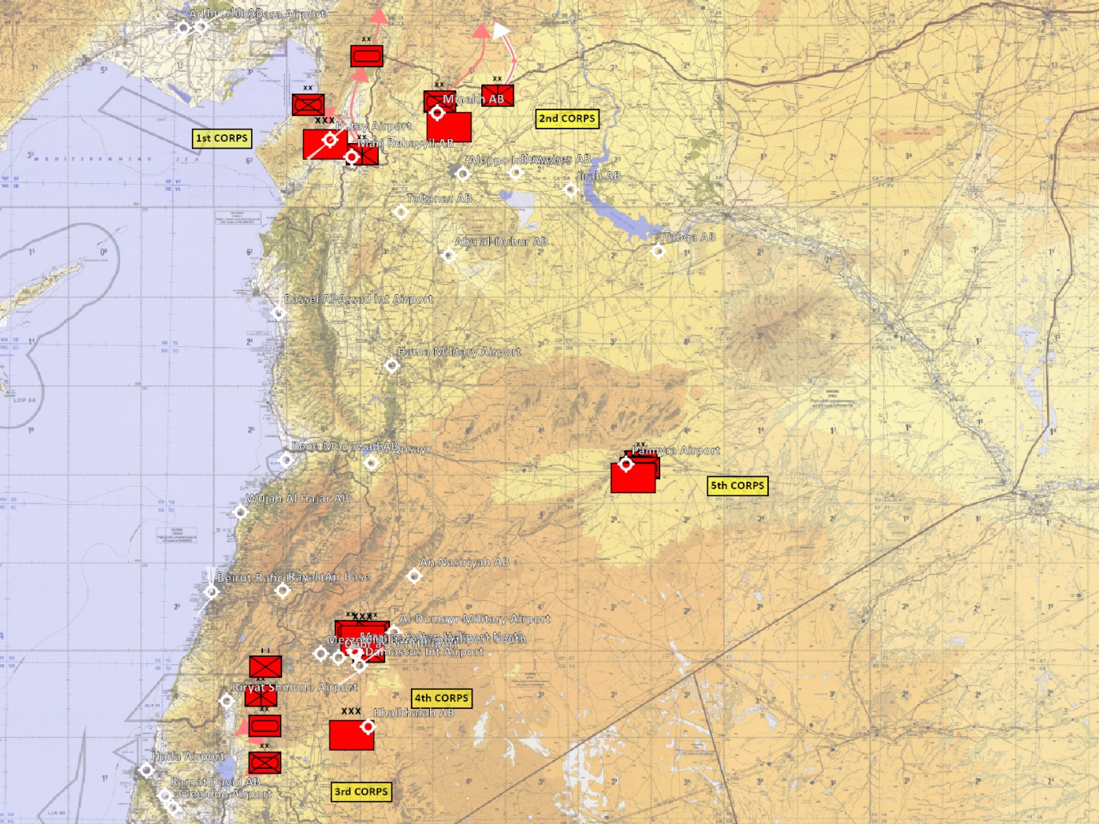
SUMMARY OF ENEMY SITUATION (facts)
1st Corps is dug in deep in area around Iskenderun, and element of 10th Armored Division is currently spotted same latitude as Incirlik.
Curently no movement of 2nd Corps as of yet.
3rd Corps is holding strong in GOLAN Heights region and are preparing for countering an Isreali offensive.
4th Corps is protecting Damaskus
5th Corps are currently stationary however is expected to be able to move within days if needed.
INSERT MAP HERE
A
A
B
B
C
C
D
D
E
E
F
F

Slide 17
ASSESSMENT OF ENEMY SITUATION (Short term)
10th Armour Division is anticipated capture and hold vitial crossroad between Incirlik and Gaziantep. Spearheaded platoons are very close to the crossroad.
2nd Corps is expected to hold until 10th Armour Division reaches its position.
3rd Corps will remain in a current hold waiting for the inevatable attack from Isreal and it’s allied. 32nd Motorized Division seems to be further to the west which can be an idication of Syrian forces trying to take Kiryat Shmona Airfield and low country all the way to the Lebanon border.
4th Corps have shown no indication of movement so far and is anticpated to stay and protect Damaskus
5th Corps will continue preparing to move if needed.
INSERT MAP HERE
A
A
B
B
C
C
D
D
E
E
F
F

Slide 18
ASSESSMENT OF ENEMY SITUATION (long term)
Long term Syria is expected to take as much land as possible to positions itself as a force to be reckoned with.
It will give the country a better leverage in the future during international negotiations.
INSERT MAP HERE
A
A
B
B
C
C
D
D
E
E
F
F

Slide 19
INTELLIGENCE GAPS
Where are the Syrian SCUD units?
Are there any movement to positions of 4th Corps and 5th Corps and if so in which direction?
INSERT MAP HERE
A
A
B
B
C
C
D
D
E
E
F
F

